Slide 1
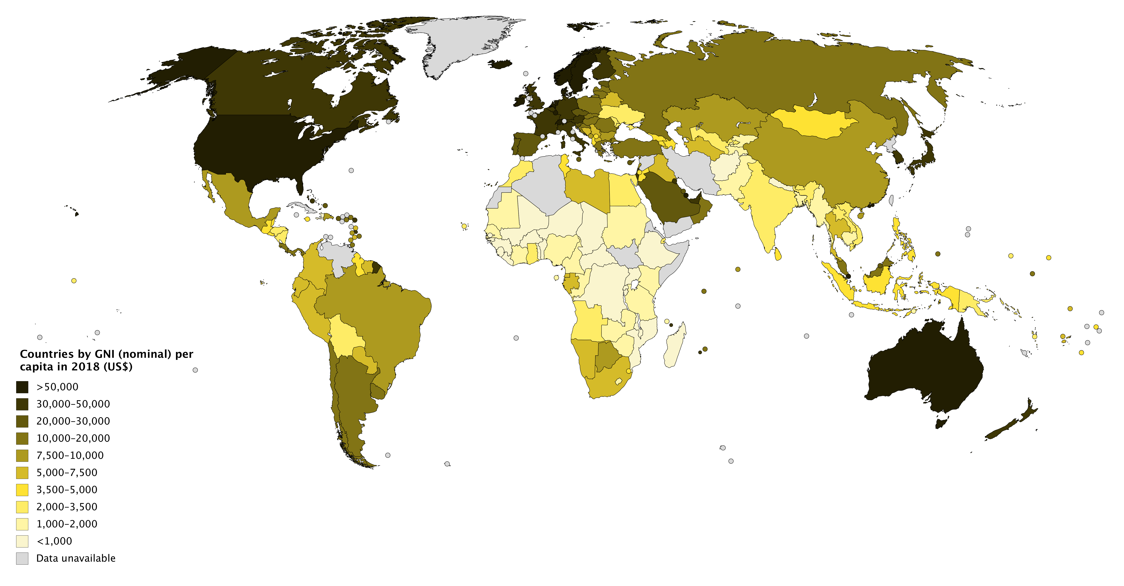
Factors affecting the GNI per capita—birth rates, death rates, infant mortality rates, life expectancies, and regions
Ophelia Li

Slide 2
Introduction
The Gross National Income (GNI) per capita is the dollar value of a country's final income in a year, divided by its population. The GNI per capita is a good indicator of a country's economic strengths and the standard of living of the average citizen. Several factors are often mentioned to influence the GNI per capita. In this report, we want to investigate how birth rates, death rates, life expectancies, infant mortality rates, and regions affect the GNI per capita for 173 countries.

Slide 3
Data Selection
The data was taken from the World Bank Open Data (https://data.worldbank.org/) and was from year 2018. The data consist of 8 variables for 173 countries.
birthrate: live birth rate per 1,000 of population
deathrate: death rate per 1,000 of population
lifeexpM: life expectancy at birth for male in years
lifeexpF: life expectancy at birth for male in years
infantdeaths: mortality rate of infants per 1,000 live births
GNIpercapita: gross national income per capita in US dollars
region: each country is categorized into a geographic region as follows:
1. East Asia & Pacific
2. South Asia
3. Europe & Central Asia
4. North America
5. Latin America
6. Middle East & North Africa
7. Sub-Saharan Africa
country: country names

Slide 4
Objective
Investigate if GNI per capita can be well predicted by the factors mentioned in the dataset—birth rate, death rate, infant death rate, life expectancy, and region.
Apply transformations to improve the predictability of the model.

Slide 5
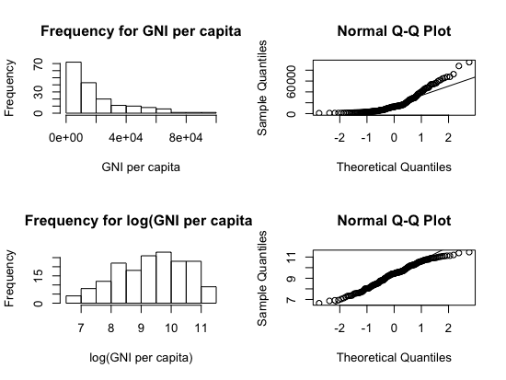
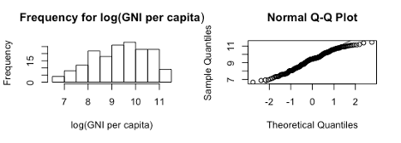
Summary of the Data

Slide 6
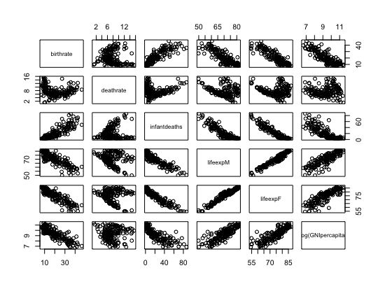
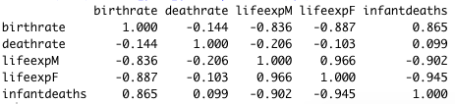
Covariates
we eliminate “lifeexpM” and “lifeexpF” variables and introduce two new variables that can better address the effect of life expectancy on the GNI per capita:
life.exp.avg: the average life expectancy at birth for both males and females
life.exp.diff: the difference in average life expectancy between males and females

Slide 7
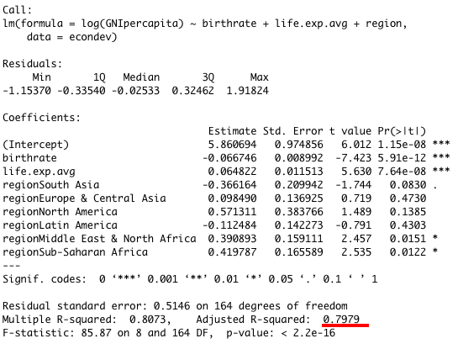
Linear model

Slide 8
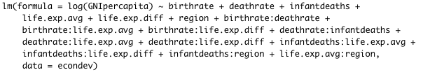

Adding Interaction Terms

Slide 9
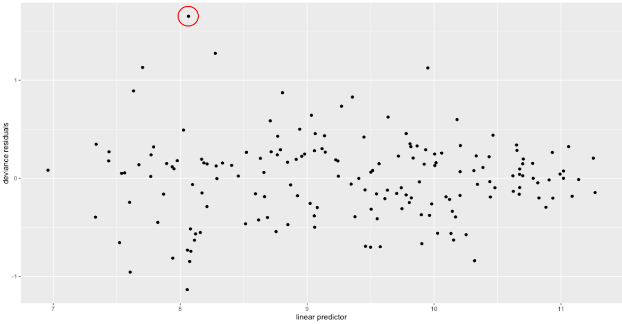
residuals vs. fitted values plot and outliers
birthrate | deathrate | lifeexpM | lifeexpF | infantdeaths | GNIpercapita | region | country
33.73 | 9.54 | 57.06 | 59.26 | 64.5 | 16604.36 | 6 | Equatorial Guinea

Slide 10
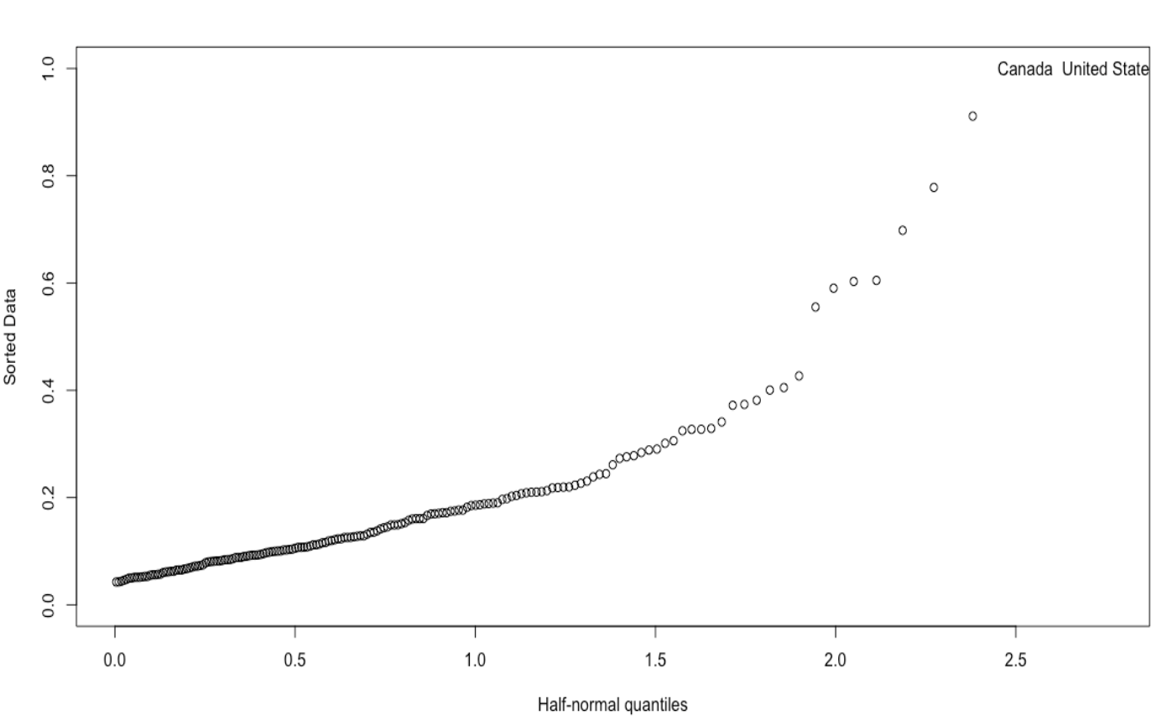
Half-normal plot and Outliers

Slide 11
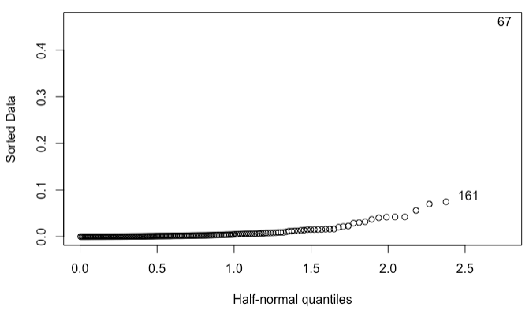
Influential Points
67-Turkmenistan
161-Haiti
After removing two influential points, the adjusted R-squared improves from 0.8374 to 0.8436
birthrate | deathrate | lifeexpM | lifeexpF | infantdeaths | GNIpercapita | region | country
19.38 | 5.1 | 69.67 | 75.62 | 10.6 | 13686.02 | 6 | Libya
24.62 | 7.06 | 64.5 | 71.45 | 40.6 | 13615.49 | 3 | Turkmenistan
14.6 | 5.8 | 70.13 | 75.22 | 20.4 | 13513.4 | 3 | Azerbaijan

Slide 12
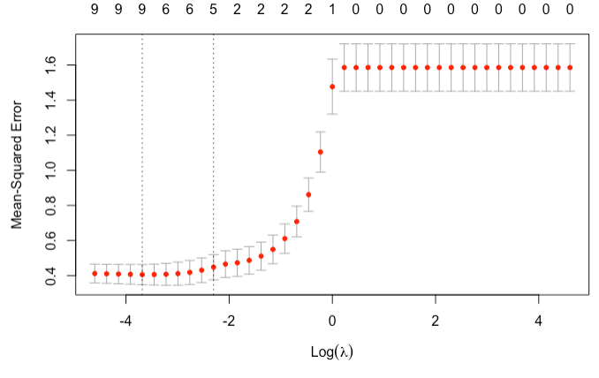
Lasso with cross validation
The exact lambda value is 0.02511886

Slide 13
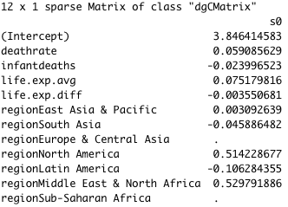
Lasso with cross validation
We see that this model differs from the best-fitted model chosen by AIC by replacing the predictor birthrate by deathrate, infantdeaths, and life.exp.diff.

Slide 14
Conclusions and Future Directions
The GNI per capita can be well predicted by the indices of economic development included in this dataset, especially after a logarithmic transformation has been applied.
Other economic data may also affect the GNI per capita that this dataset does not include. Examples are education level, inflation and exchange rates.
Many other quantities for assessment of standard of living such as the Human Development Index (HDI), Genuine progress indicator (GPI), and OECD Better Life Index.

